Slide 1

Welcome!

Slide 2

#spsmad
We want to be trending topic in Spain!

Slide 3
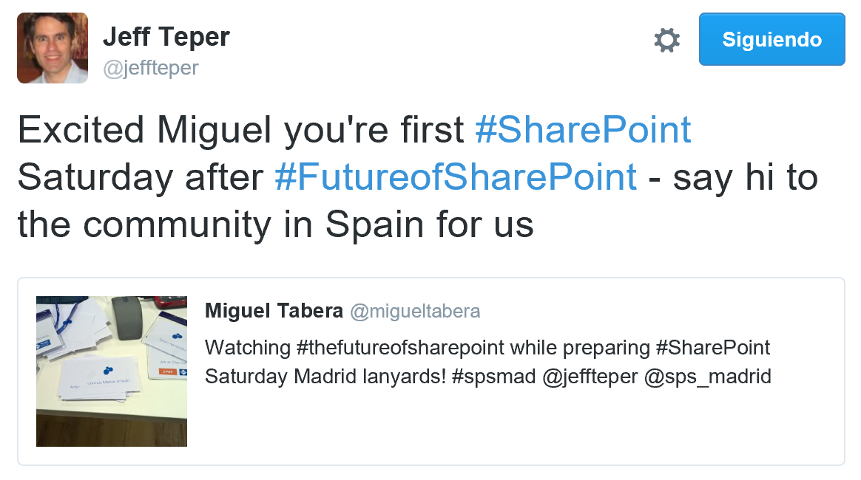
Hello from Seattle
Jeff Teper
OneDrive & SharePoint, Corporate Vice President, Microsoft

Slide 4
Important events
11:00 am → Coffee break
1.30 pm – 3.00 pm → Lunch
Don’t miss our gold sponsors sessions during lunch!
6.00 pm → SPS Madrid raffle
6.30 pm → SharePints

Slide 5
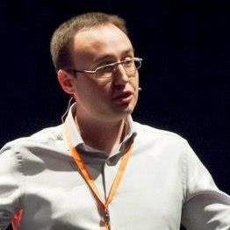

Join our SharePints
At 6.30 pm, all you are invited to our SharePints!
Remember this guy →
He will guide us to the SharePints

Slide 6
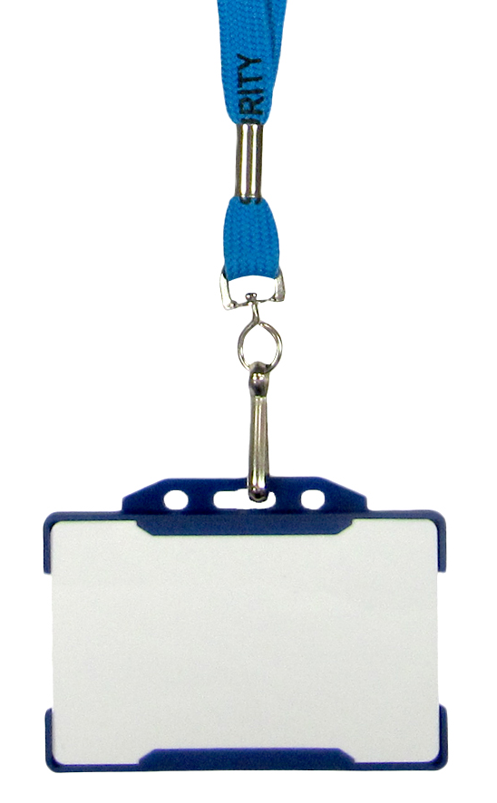


I need help!
Ben Solo
STAFF
General attendees Staff / Speakers

Slide 7
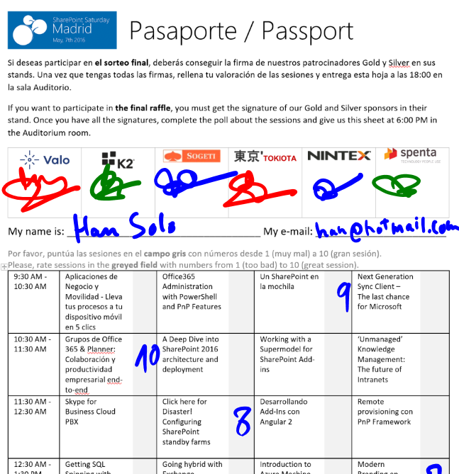
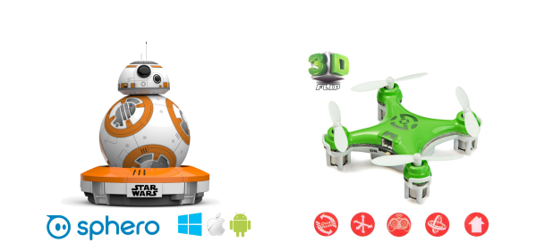
Raffle
Please, fill your SPS Madrid passport if you want to participate.
You can win one of these gifts:

Slide 8
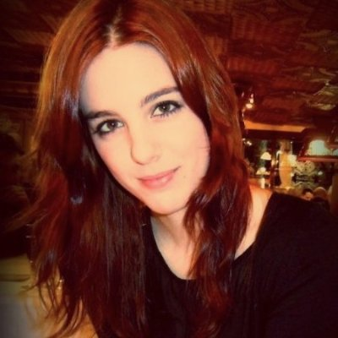
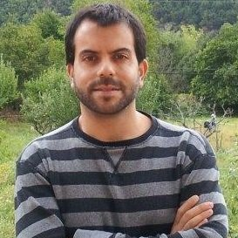
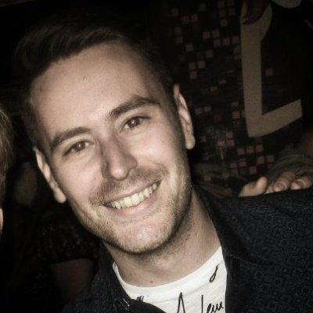
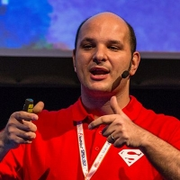
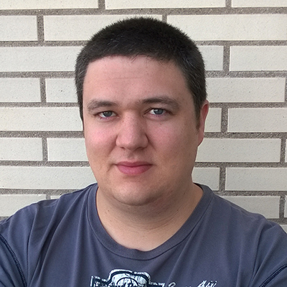
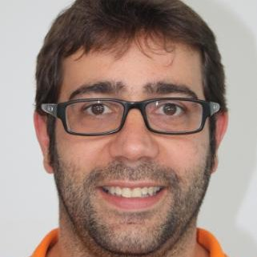
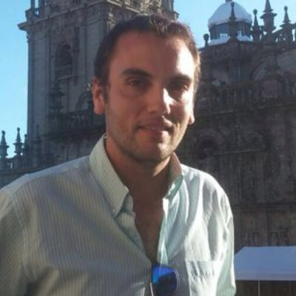
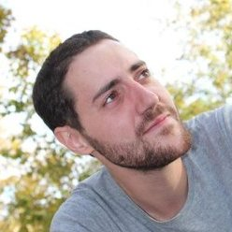
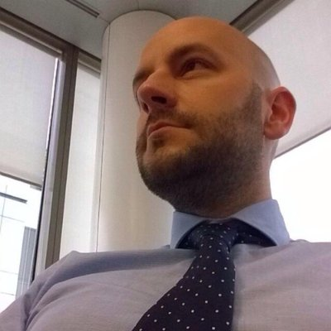
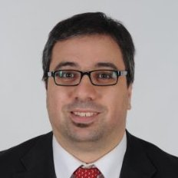
Organizing team
Olga Martí
Juan Carlos González Martín
Samuel Zanetti
Edin Kapic
Miguel Tabera Pacheco
Adrián Díaz Cervera
José Carlos Rodríguez Avilés
Pablo Peris
Christian Ruiz
Héctor Calvarro
Rafael Ansino Lara

Slide 9




Technical Communities

Slide 10
Notes:
This slide is mandatory. Please do not remove and try to use it during Q&A at the end of your session. Thank you!

Slide 11
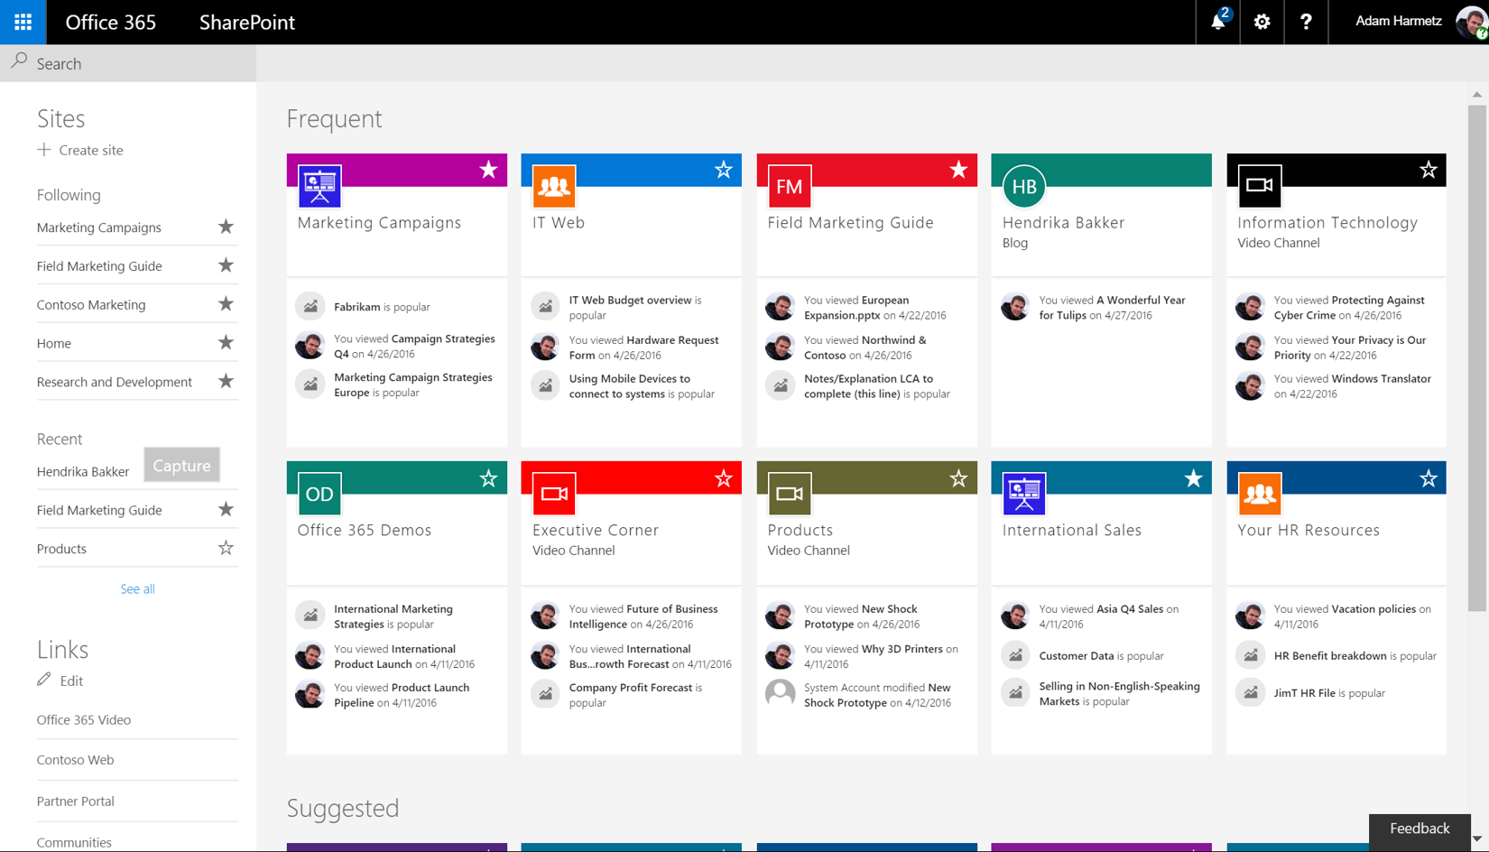
Sessions that mention #futureofsharepoint
‘Unmanaged’ Knowledge Management: The future of Intranets
Pablo Peris
Grupos de Office 365 & Planner: Colaboración y productividad empresarial end-to-end
Juan Carlos González
¿Merece la pena SharePoint 2016? Puntos de vista de un IT PRO, desarrollador y Power User
Miguel Tabera
Next Generation Sync Client – The last chance for Microsoft
Hans Brender
Desarrollando Add-Ins con Angular 2
Adrián Díaz
Working with a Supermodel for SharePoint Add-ins
Sonja Madsen
Desarrollo de soluciones avanzadas con Office Graph y Delve
José Ignacio López
Frameworks de desarrollo para SharePoint
Alberto Díaz
Office 365 Connectors for Groups
Rubén Toribio
PowerApps: controla tus datos con 5 clics
Javier Menéndez Pallo & Sergio Hernández

